Slide 1
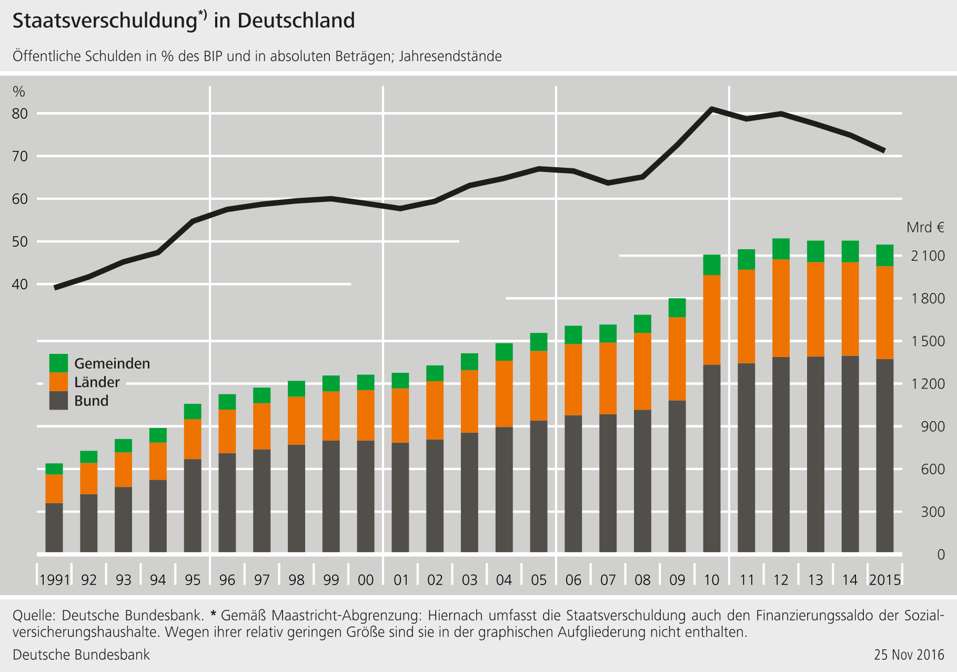
Germany‘s public debt (% of GDP)

Slide 2
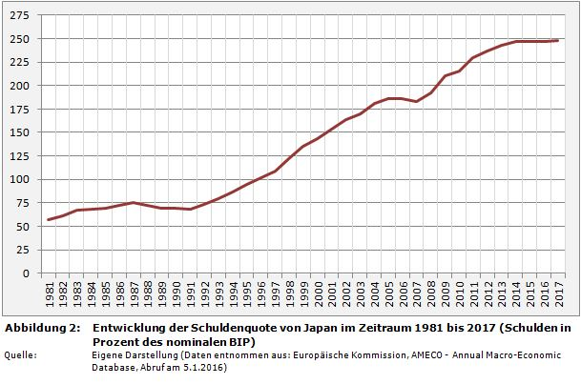
Japan‘s public debt (% of GDP)

Slide 3
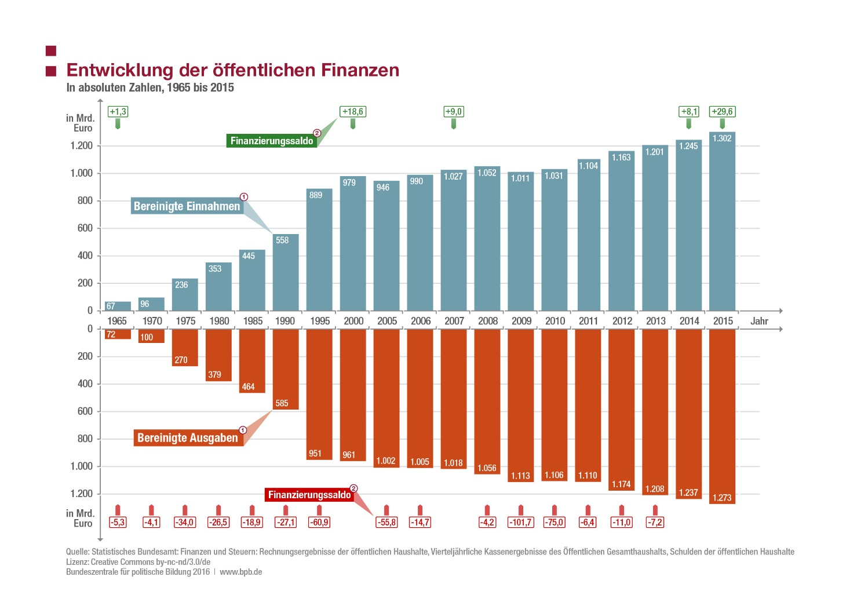
Evolution of public finances in Germany (1965-2015)

Slide 4
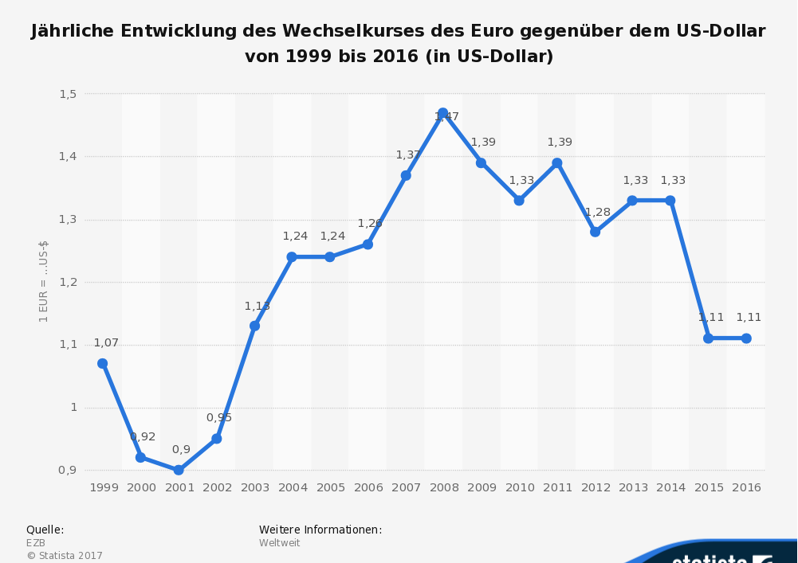
Exchange rate €uro - Dollar
(1999-2016) in $

Slide 5
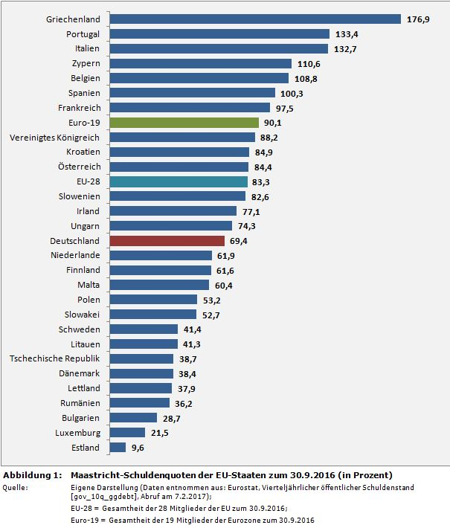
Debt (% of GDP)
of the EU member states

Slide 6
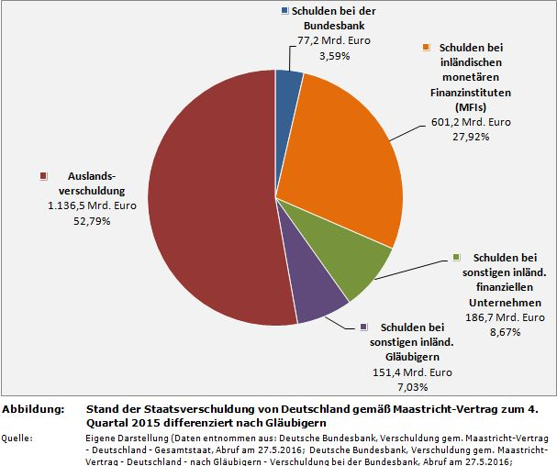
Who does Germany owe money to?

Slide 7
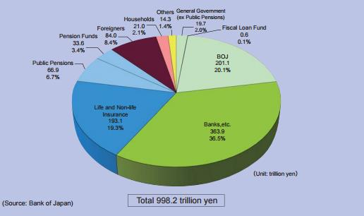
Who does Japan owe money to?

Slide 8
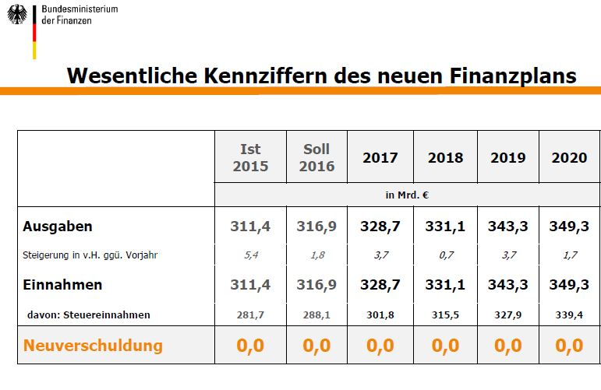
Key figures of the financial plan 2015-2020

Slide 9
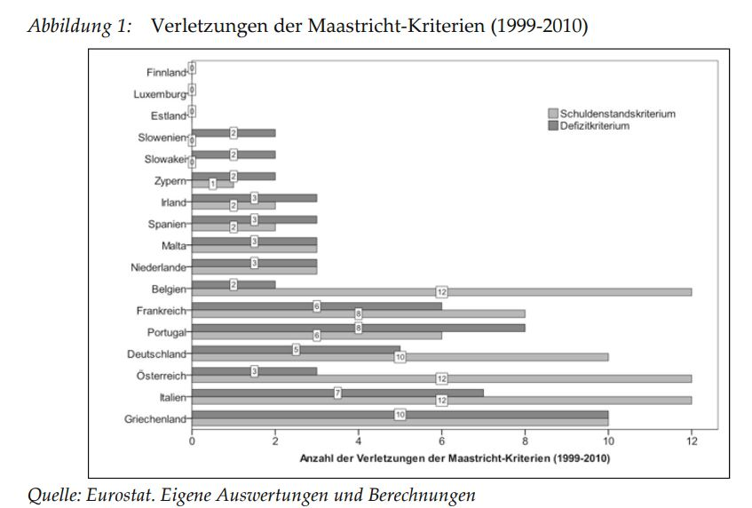
Breaches of the Maastricht criteria (1999-2010)

Slide 10
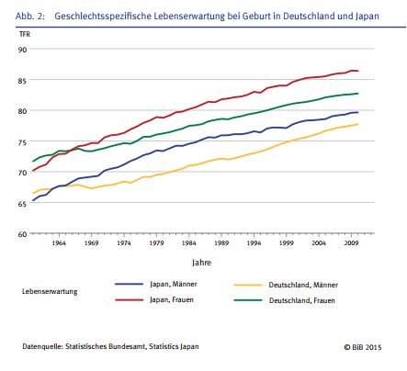
Gender-specific life expectancy in Japan & Germany

Slide 11
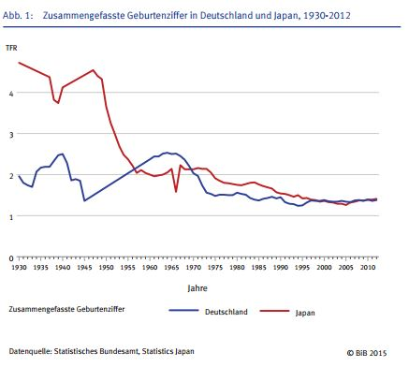
Birth rate in Japan & Germany

Slide 12
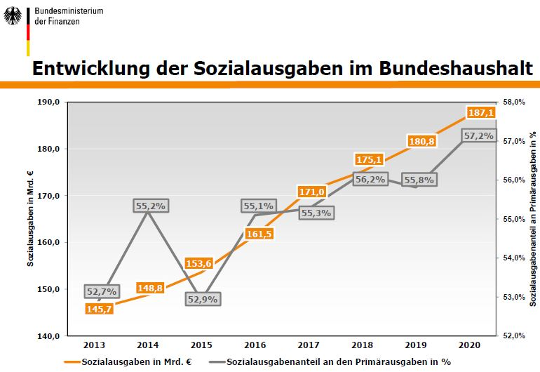
Social expenditure as % of german federal budget

Slide 13
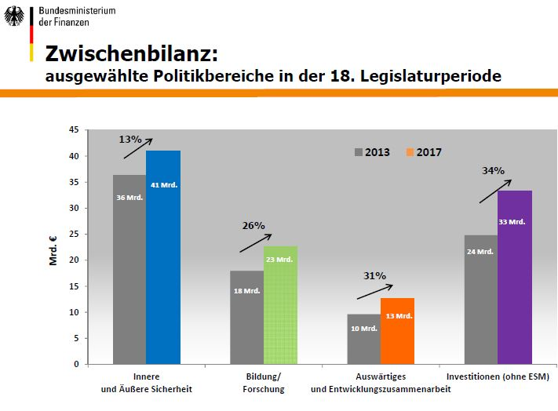
It is not an austerity policy
Internal & external security
Education
Foreign affairs & development cooperation
Investments
(without ESM)

