Slide 1
DIJ Forum
Androids and Virtual Reality―
Simulations of the Human
in Japanese Theatre
(Android section)
Mari Boyd
Sophia University

Slide 2
Karakuri Puppets １７ｃ-１８ｃ
Zashiki Karakuri (collector’s items)
Festival Karakuri
Stage Karakuri
Takeda Theatre (1622-1768),
f. Takeda Omi I

Slide 3
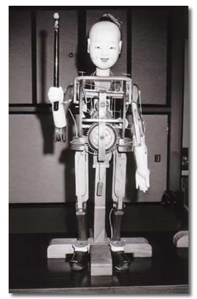
Zashiki Karakuri Head-ｂobbing doll’s mechanism

Slide 4
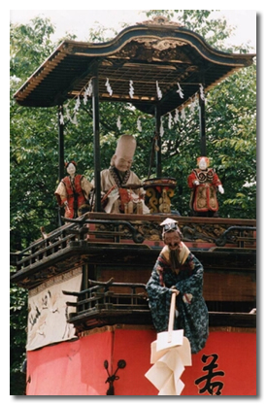
Festival Karakuri (1730-)

Slide 5
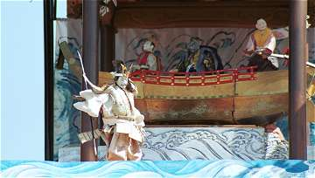
Stage Karakuri Takeda Karakuri Theatre Benkei in the Boat scene 2

Slide 6
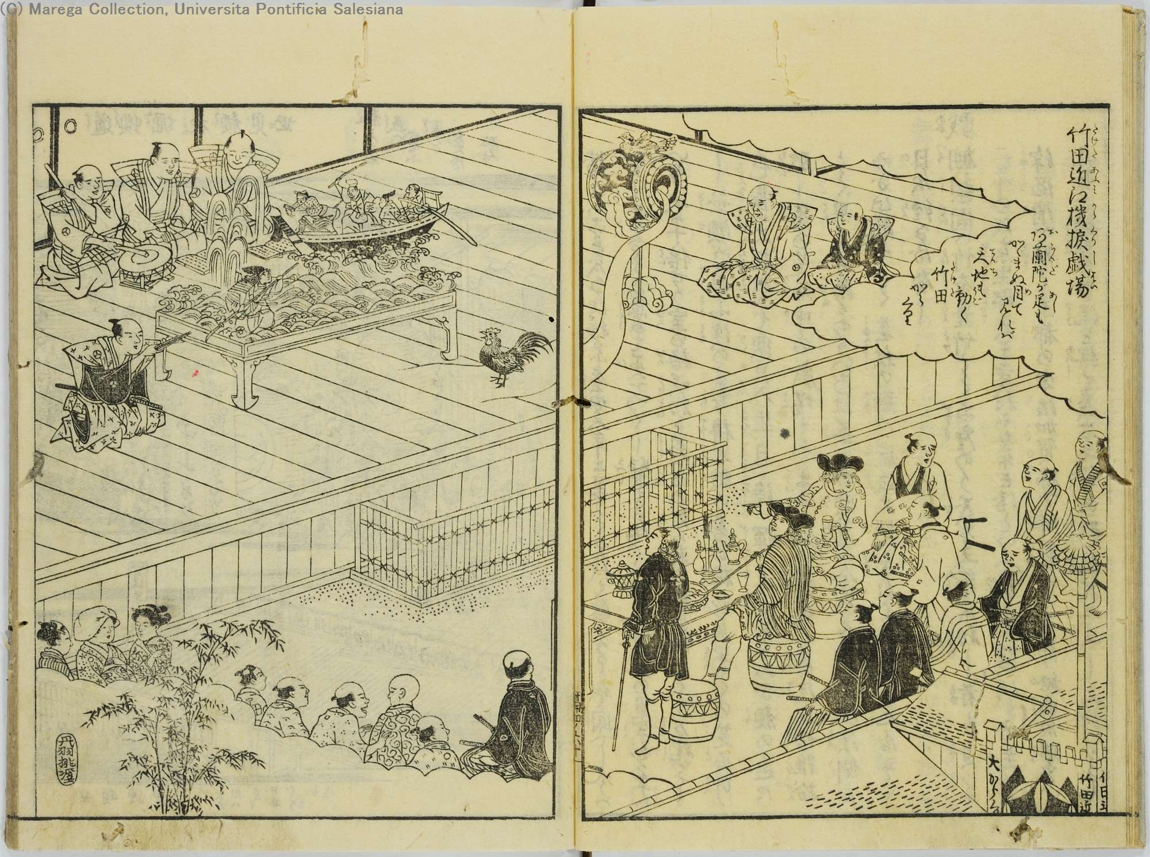
Takeda Oumi Karakuri Staging

Slide 7
Rivalry & Connections
Joruri/bunraku theatre
Three skills of chanted narration, shamisen accompaniment, puppet manipulation
1. Takemoto Theatre (1685-1767）joruri
f. Takemoto Gidayu; Chikamatsu Monzaemon
2. Toyotake Theatre (1703-1765) joruri
f. former Takemoto member (Toyotake Wakatayu)

Slide 8
How did Karakuri continue to contribute to theatre?
1. Development of small stick puppets to the present large 3-man puppets from 1716 to 1765.
From 1705, Takeda Omi I is TM manager.
1716 Takeda Izumo I (-1747) joined TM.
By 1727, TM added eyes and mouth that opened/ closed and hands that moved.
1733 TM made articulated fingers.
1734 TM devised 3-man puppet.
1736 Toyotake doubled 3-man puppet’s height to 4 ft.
1765 Joruri reached its present form

Slide 9
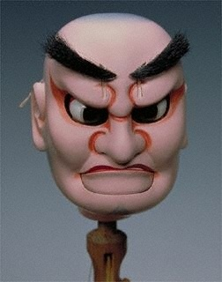
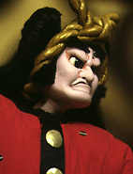
Watonai’s Face Chikamatsu Monzaemon’s The Battles of Coxinga (1715)

Slide 10
The internal structure of a bunraku head

Slide 11
Samurai and Demon Facial Expressions

Slide 12
Three-man Puppet Manipulation

Slide 13
How did Karakuri continue to contribute to theatre?
2. Stage mechanisms
1716–1735 Revolving chobo platform for chanters /musicians
1740s-
Central revolving stage (mawari- butai
stage lift (seri)
roof-turning device (yatai-gaeshi)
alter-turning device (butsudan-gaeshi)
flying the character/actor (chuzuri-)

Slide 14
Towards Society 5.0
Society 1.0 hunting society
Society 2.0 agricultural society
Society 3.0 industrial society
Society 4.0 information society
Society 5.0
(ref. Cabinet Office website)

Slide 15
Achieving Society 5.0 (1)
-Convergence btw cyberspace and physical space.
-Big data collected in cyberspace; analyzed by AI.
- People, things, and systems are connected in cyber-space and optimal results, obtained by AI exceeding human capabilities, are fed back to physical space.
-This process brings new value to industry and society and will help balance economic development and solve social issues.
(ref. Cabinet Office website)

Slide 16
Achieving Society 5.0 (2)
Social issues: rising demand for energy & food; ageing society, international competition (e.g. concentration of wealth and regional inequality)
New technologies like IoT, robotics, AI, and big data will assist in industries and activities to provide goods/services without disparity. Processes will speed up. (e.g. Self-driving cars, cashless society and more.) (ref. Cabinet Office website)

Slide 17
Society 5.0
Foreseeable Results:
Reduction of GHG emission/ Increased production of food & reduction of waste/ Mitigation of costs associated with an ageing society/Promotion of sustainable industrialization / Redistribution of wealth and correction of regional inequality.
(ref. Cabinet Office website)

Slide 18
Branding Japan as a Society 5.0
AIM: Robot-human collaborative society
Humanoid Robotics Project (HRP 1998-2003)
Innovation 25 (2007-2025), Inobe family “Convenience, security, comfort”
Robot Revolution Realization Council (2014)
next generation robots
2015—Year of Robot Revolution with a “New Strategy for Robots”

Slide 19
HRP Robot Technologies
Motion capture
Real time Linux
Voice Recognition
Degrees of freedom
Bipedal movement
Robot Simulator
Human body dimensions database etc.
User Centered Robot Open Architecture
RT Middleware

Slide 20
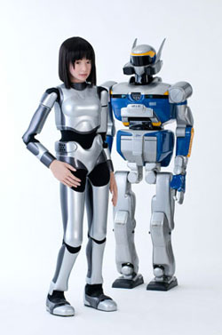
Kawada HRP-2 & HRP-4C

Slide 21
Innovation 25 (2007-2025)
1. Setting the goals high and anticipating challenges.
2. Timely and effective response to globalization and advancement of informatization.
3.Significance of the perspective of ordinary citizens.
4.Innovation through diversification and reform of society
5.Primary importance on HR development—to encourage people to think creatively

Slide 22
“A Day in the Life of the Inobe Family” (2007)
Convenience, Security, and Comfort
Father—works at his own venture company;
Is he ikumen or not?
Mother – teleworker & robot supervisor
Two children and healthy grandparents
Next generation robot named Inobe (伊野辺）

Slide 23
Retro-Tech
Anthropologist Jennifer Robertson in her
Robo-Sapiens Japonicus (2018) says that Japan’s concept of a robot-human interactive society is a kind of RETRO-TECH or advanced technology in the service of traditionalism.

Slide 24
Seinendan (Youth Group) + Osaka University Robot Theatre Project
Playwright-director Hirata Oriza & Roboticist Ishiguro Hiroshi, both of Osaka University.
Their objective: to explore first “what it means to be human” and second “what human sociality is” by developing better communication between robots and humans through building androids with humanlike expressive abilities rather than highly developed mobility as in industrial robots.

Slide 25
Sayonara (2011) Owlspot Theatre Lobby

Slide 26
Android Theatre Sayonara

Slide 27
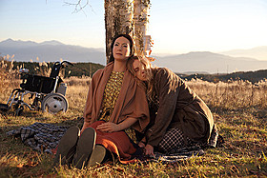
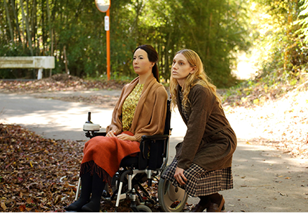
Sayonara, film version

Slide 28
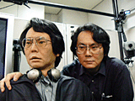
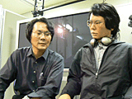
Hiroshi Ishiguro’s Geminoid (Doppelgänger）

Slide 29
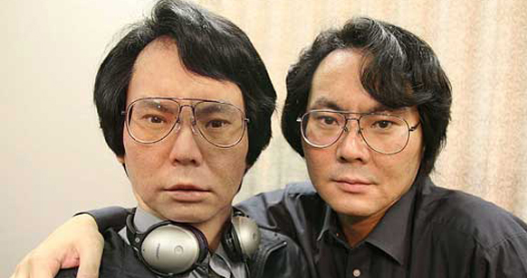
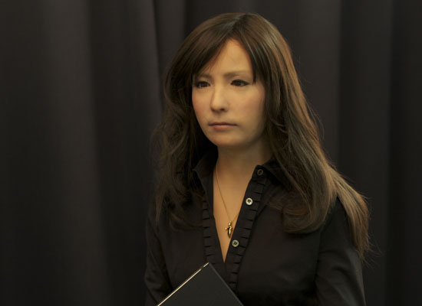
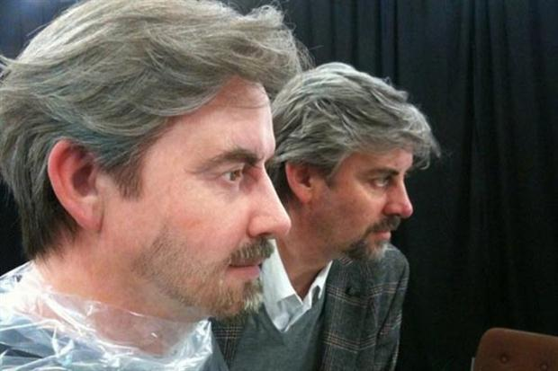
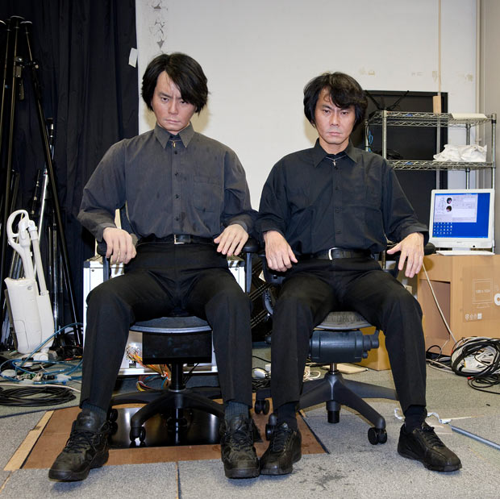
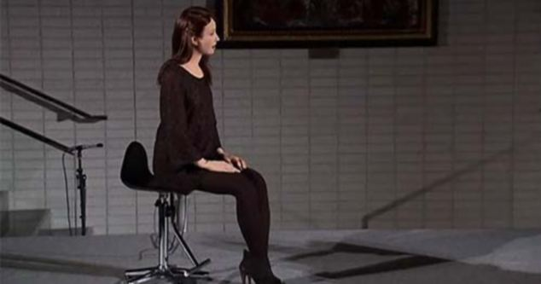
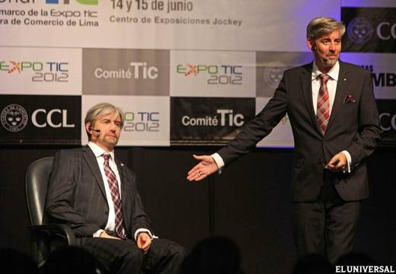
Geminoid HI
Geminoid F
Geminoid DK

Slide 30
Human Expressivity Engineering
Three overlapping considerations can be identified in the application of new technology to human expressivity:
The illusion of living presence
The cultural construction of kokoro
Design methodology

Slide 31
Living presence
The most important factor in creating the illusion of living presence is:
TELEOPERATING: We can autonomously control androids by transferring an operator’s movement measured by a motion-capturing system. (Ishiguro)
Timing
Movement
Looks/voice
Lighting

Slide 32
Construction of kokoro
1. Definitions of kokoro
Kokoro no longer means heart or soul, but action, consciousness, unconscious, etc. The most prevalent understanding of kokoro today is “as action.”
2. Identification with androids (tpo)

Slide 33
Identification with Androids

Slide 34
Design Methodology (0)
Three Purposes of Design Methodology
To enhance expression of positive humanlike qualities in robots
To evoke expression of positive humanlike qualities in the interaction between robots and humans.
To preempt the uncanny valley effect

Slide 35
Design Methodology 1
To enhance expression of positive humanlike qualities in robots
Face-tracking for smooth shifts in facial expression
Skin quality―smooth, silky silicone
“Idling” ―yuragi/microslips, ideomotor action (involuntary movement)
The gaze—

Slide 36
Design Methodology 2
2. To evoke expression of positive humanlike qualities in the interaction between robots and humans.
·Kokoro construction: what humans learn through “socialization” can be programmed.

Slide 37
Design Methodology 3
3. To preempt the Uncanny Valley effect
What is the Uncanny Valley?
What is the uncanny?

Slide 38
The Uncanny Valley
The bukimi no tani derives from Mori Masahiro’s yet-to-be-proven 1970’s hypothesis on how “excessively realistic simulations of living creatures elicit an instinctive revulsion.”

Slide 39
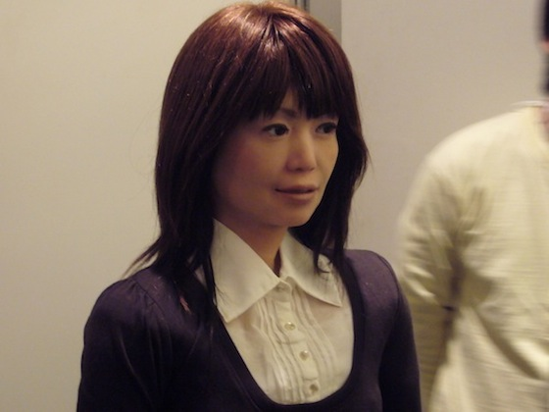
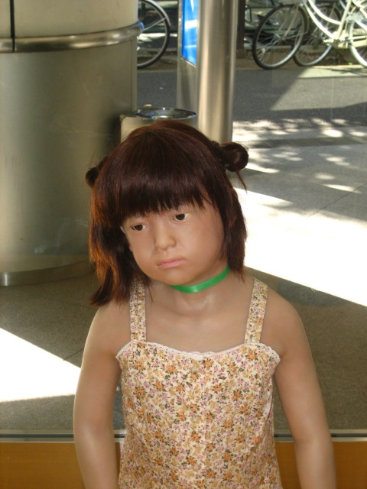
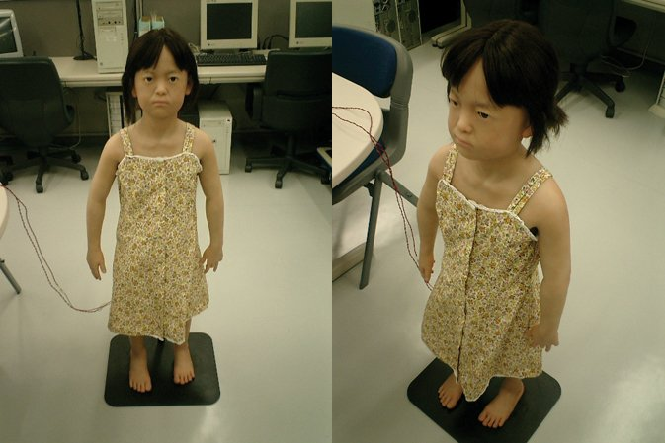
Repliee R1
Repliee Q2

Slide 40
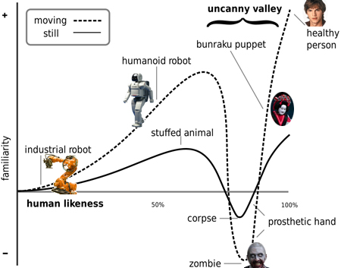
The Uncanny Valley

Slide 41
Design Methodology
How to preempt the uncanny valley effect
Match movement/voice and appearance.
Provide continual low oscillation (breath, blinking, rocking) that replicates autonomous nervous system (ANS)-centered vibration.

Slide 42
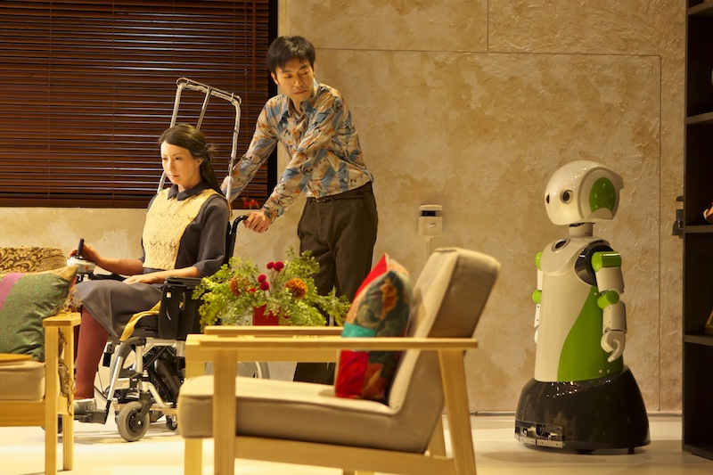
Three Sisters, Android Version

Slide 43
Three Sisters, Android Version
Synopsis: The Fukazawa family resides in a declining provincial town with a dwindling robotics industry. Like the Prozorovs of Chekhov’s play, the father is deceased; but he still seems to control his family through his morbid will. When Ikumi became a shut-in, her roboticist father built her a Geminoid F, as a companion, but also mislead the world to believe that she had died. The play begins on the day of a modest farewell party for a young scientist, who is moving to Singapore.

Slide 44
Three Sisters

Slide 45
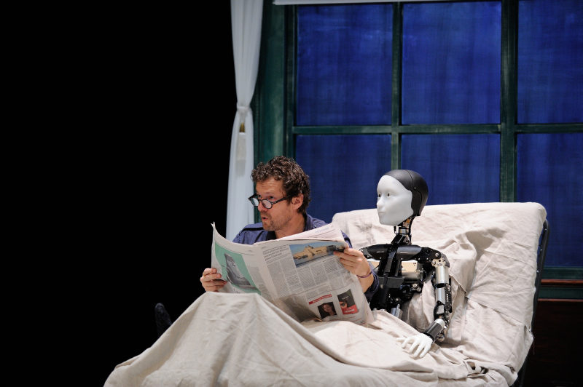
La Metamorphosis, Versión Androide

Slide 46
Gakutensoku
The End

Slide 48
Hirata’s Contemporary Colloquial Theatre
Characteristics
Discourse of the said, unsaid, unsayable
Alterity within intimacy
Focus on the quotidian over the sensational
Insider, outsider, intermediary functions
Semi-public setting

Slide 49
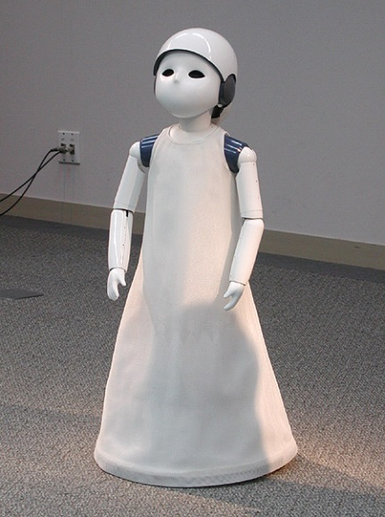
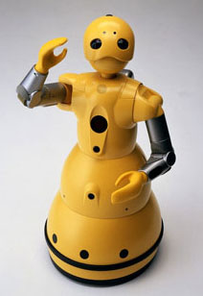
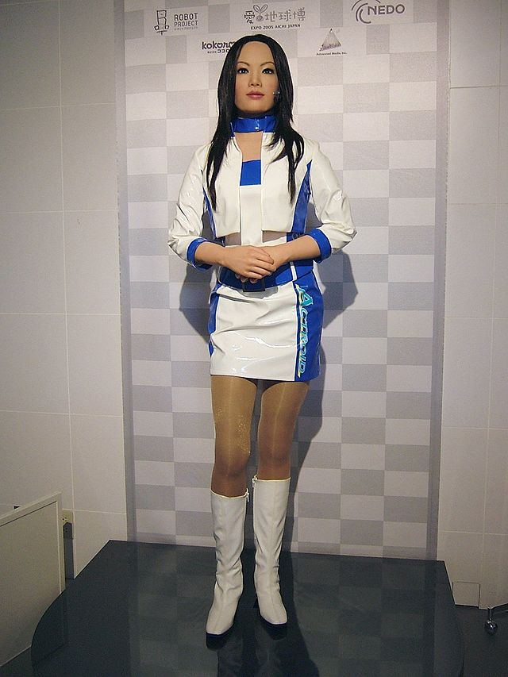
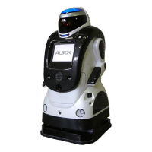
Non-Ishiguro’s robots

Slide 50
Extended Uncanny Valley

Slide 51
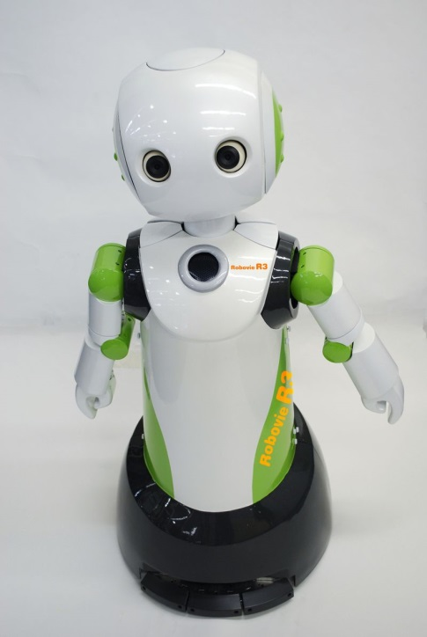
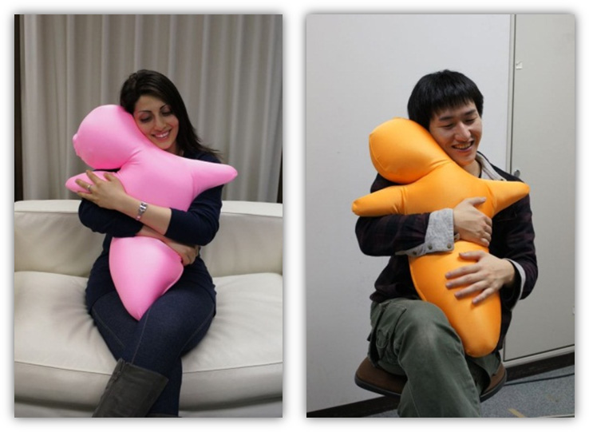
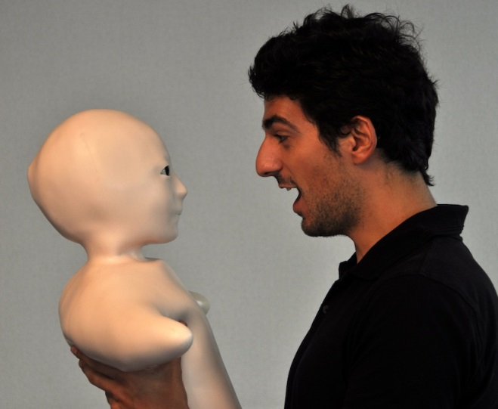
Ishiguro’s Minimal Design Humanoids
Robovie
Hugvie
Telenoid

Slide 52
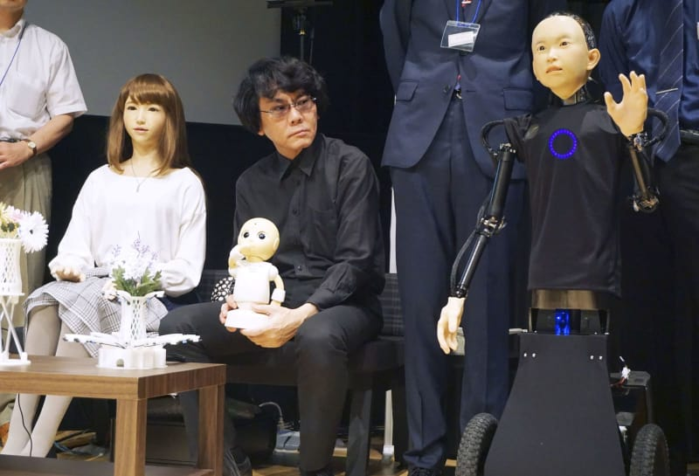
ERICA, Ishiguro, ibuki

Slide 53
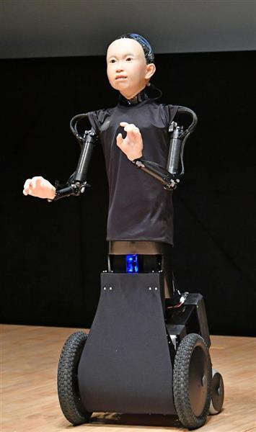
ibuki

Slide 54
Emotional Expression in Conversation

Slide 55
Gakutensoku (1929/ 2008)

Slide 57
The Dogushi Mechanism

Slide 58
Robot Revolution Realization Council (RRRC, 2014)
“New Strategy for Robots”
to make Japan the world’s most advanced robot showcase and achieve a society in which robots are utilized more than anywhere else in the world, from nursing care and agriculture to small- and medium-sized enterprises. To that end, we are engaged in achieving a ‘robot barrier free’ society through regulatory reform and establishing the highest level of artificial intelligence technologies in the world.

