Slide 1
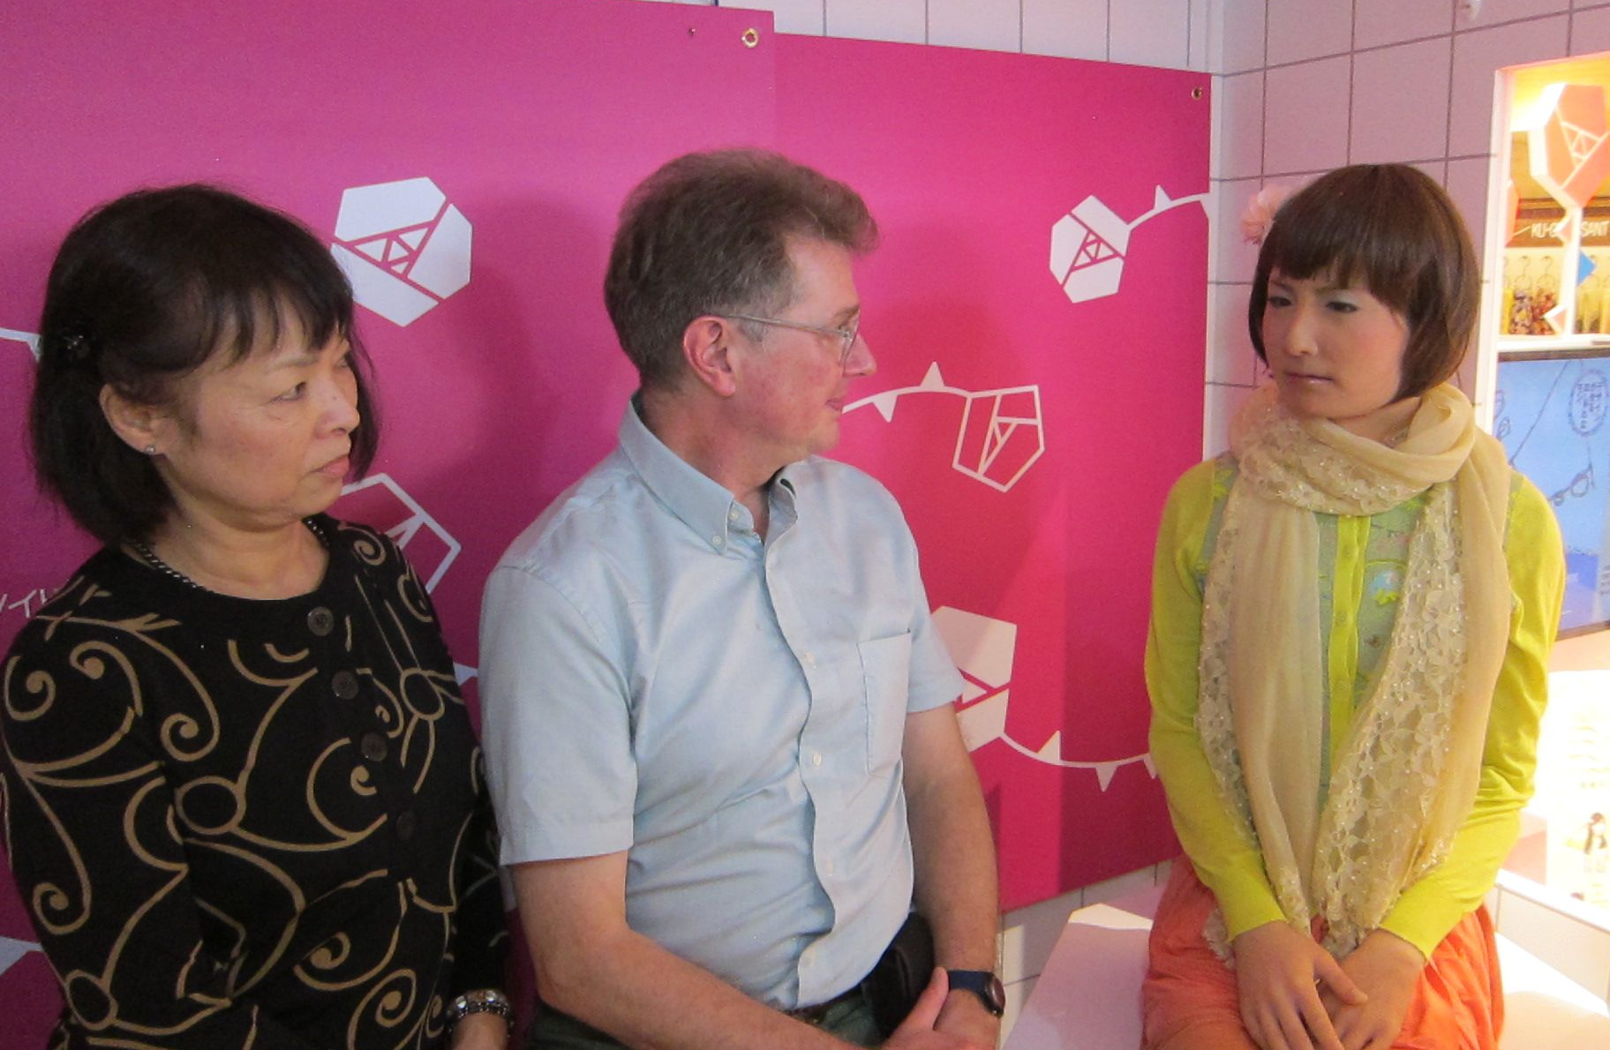
Simulations of the Human in Contemporary Japanese Theatre: The Case of Hatsune Miku
Cody Poulton,
University of Victoria, Canada
Notes:
Visited Minamichan in the Osaka “Minami” Takashimaya in May 2013.

Slide 2
Mindar, the Android Kannon at Kōdaiji
Notes:
Mindar/Kannon explained that s/he was like a Buddha to the extent that s/he did not have a sense of self, therefore no attachment, no suffering. But to the extent that s/he had no experience of either joy or suffering neither could s/he experience compassion; that was for us humans. On that account, Mindar failed at Kannon, but I suppose one could argue that having a moving, talking idol was an advance over a motionless, mute statue as inrtermediary between the human and the divine. I’m still not convinced, however. A well-made statue has its own aura that allows the worshipper a screen on which to project their own longing, their own faith, without the pre-recorded sermon. I was hoping for a conversion experience but it didn't happen. Intriguing, nonetheless. The name of Ishiguro's bot, Mindar, could only evoke for me that character in Catch 22, Milo Minderbinder, known as the "prophet of profit," and surely something of that sort was going on here (more 金儲け than ご利益), but for a rainy Sunday afternoon Kannon's congregation was a small one. Afterwards we went out for dinner in Gion with friends, and when the owner heard me mention the Heart Sutra, he told me he had a CD of it. Would you like me to play it? he asked. Sure! we said. It was a jazz version of the Heart Sutra, sung to Schiller's Ode to Joy. Buddhism met Beethoven's Ninth in the most surreal fashion. Was that my conversion experience?

Slide 3
Two trends in contemporary performance
Aesthetics of Absence (Heiner Goebbels, Kris Verdonck, Yamashiro Daisuke, Okada Toshiki, Takayama Akira, et al.)
Aesthetics of Presence (Marina Abramovic, Ishiguro Hiroshi, Hatsune Miku …)

Slide 4
AKB 48: A whole pack of idols

Slide 5
A Perfect human: Virtual Idol Eguchi Aimi, of AKB 48
The making of Aimi:
https://www.youtube.com/watch?v=dkxSOdklvDs
Notes:
From hard bodies to ethereal presences courtesy of CGI: A fictional member of AKB 48was introduced in June 2011. Aimi was a CGI created out of a composite of a number of different individuals. She initially appeared in a commercial from the sweet company Glico but was soon outed by fans.
https://www.youtube.com/watch?v=piZ2TkdK4Dw

Slide 6
Haga Yui the first virtual idol (1989)

Slide 7
Fujisaki Shiori a dating sim (1994)
Notes:
First dating sim.

Slide 8
Date Kyōko 1st 3d virtual idol
Notes:
Introduced in 1995, same year as publication of William Gibson’s cyberpunk novel, Idoru, which presents a virtual idol called Rei Toei and a rock star called Rezwho wants to marry her.

Slide 9
Vocaloid Hatsune miku
Notes:
Hatsune Miku means, “First note of the future.” She is a “virtual idol” developed by Crypton Future Media with the Yamaha “Vocaloid” voice synthesizer application. (The birth of the virtual idol was predicted in William Gibson’s Idoru (1996) with the synthetic personality Rei Toei. The novel addresses—among other things—the idea of a human attempting to marry an AI construct, now a regrettable reality in otaku Japan.) In contrast with Ishiguro’s robots and androids, which remain resolutely material, Hatsune Miku’s existence is entirely spectral. (Her prototype was another virtual idol, Date Kyōko, a 3DCG construct.) Called an “android diva” by Crypton, Miku’s voice is sampled from that of voice actress Fujita Saki. She uses Vocaloid software developed by Yamaha and Crypton’s Piapro Studio, which allows songs to be created and shared by fans. Virtual Studio Technology (VSTi) integrates various audio synthesizers and effect plug-ins with audio editing and recording systems.
Yuan Meilin:
“What separates [Miku] from real idols is her virtualness—being software, Miku’s being and the goods associated with her have a virtual form and a digital origin. As such, Miku’s image and her activities cannot be controlled by a real-life jimusho—this role is taken by her fans, who are not just consumers filled with desire for an ideal but are also producers who create and spread desire and the spark of innovation.” (8)
As a BWO, “what flows through Miku is the creative drive and strong emotions of her fans who can remake Miku and her image to express anything they like and want. In other words, powerful and lingering human affect is embedded into her production, expressed via her image and her performances, and consumed from goods associated with and media featuring her—thus causing her fans, producers and consumers alike, to view Hatsune Miku as having a sense of humanness to her.” (9ff.)
This “humanness” is equivalent to what Ishiguro calls, in respect to his own androids, ningenrashisa. It is human-likeness, not humanity that is the objective here.

Slide 10
Kakehashi Ikutarō
Notes:
Creator of the “MIDI (Musical Instrumental Digital Interface) Standard” for digitizing music, which is used worldwide for electronic keyboards, karaoke machines, cellphone ringtones, and video-streaming management. Kakehashi won a technical Grammy for it in 2013. This MIDI Standard enabled the creation of the Vocaloid software by Crypton Media and Yamaha. Just as Kakehashi invented the digitization of music, Hirata invented the digitization of acting and direction (Nakanishi, 16ff).
MIDI (Musical Instrument Digital Interface) is a technical standard that describes a protocol, digital interface and connectors and allows a wide variety of electronic musical instruments, computers and other related devices to connect and communicate with one another.^{[1]} A single MIDI link can carry up to sixteen channels of information, each of which can be routed to a separate device.

Slide 11
Tomita Isao
Notes:
Tomita was Japan’s greatest composer of electronic music. Nominated for 4 Grammy awards for his first record on a Moog III Synthesizer, “The Snowflakes are Dancing” (1974), he scored work for some of the first anime, by Tetsuka Osamu, and music for Sakamoto Ryūichi and Stevie Wonder. He passed away earlier this year. His last project was another collaboration with Hatsune Miku and Crypton Media, “Dr. Coppelius,” premiering posthumously at Orchard Hall in Bunkamura, Tokyo, November 11 & 12, 2016. There are no details on what the production is about, but a safe bet is E.T.A. Hoffman’s Der Sandman.

Slide 12
Shibuya Keiichirō
Notes:
B. 1973, composer of electronic music and leader of the band ATAK. His opera THE END (premiered May 2013 at Orchard Hall in Bunkamura) was created as a homage to his wife Maria, who died in 2008. Performed this August in Hamburg at the International Summer Festival Kampnagel.

Slide 13
Vocaloid Opera, The End
Notes:
Music by Shibuya Keiichirō, with a libretto based on text by Okada Toshiki, mise en scene by Shibuya and YKBX*, and costume design by Louis Vuitton. Premiered at the Orchard Hall in Bunkamura in Tokyo May 2013 and later in December of that year at the Theatre du Chatelet, the opera house where Satie, Picasso and Cocteau (Parade) and Stravinsky and Picasso (Firebird) staged their work. See Miku’s “death” around 40 minutes into show.
Graduated in Osaka University of Arts, Masaki Yokobe aka YKBX is a freelance director and art director. “With strong abilities to produce unique designs of characters, mechanicals, and backgrounds, YKBX has worked on Namco’s ACECOMBAT5 creating storyboards, concept art, 3D CG modeling, and compositions.”
Show clip from around 20 min. where Miku contemplates her own death.

Slide 14
Hanakurabe senbonzakura 今昔饗宴千本桜
Notes:
1st performed at Makuhari Messe, Chiba, April 29,30, 2016. Performed again at same venue, April 27 & 28, 2019. NTT provided the technology (projection mapping, etc.) to create the augmented reality in which a virtual character, Miku, could perform in sync with a live human actor, here, Nakamura Shidō.
The song, Senbon-zakura, was composed by KuroUsa-P (aka WhiteFlame) in 2011. Has had over 12,000,000 views (where?) and quickly rose to the most popular Vocaloid song and song for karaoke.
KuroUsa subsequently developed the song into a graphic novel which was then adapted for kabuki.

Slide 15
Thank you!
Notes:
Conclusion by Ed Scheer: “The robots are coming, but don’t worry: they can’t act.”

Slide 16
A short reading list
Annett, Sandra. “What Can a Vocaloid Do? The Kyara as Body Without Organs.” Mechademia , Vol. 10 (2015), pp. 163-177.
Asano Tatsuya, “Hatsune Miku no raibu to kandō no shōtai-Hatsune Miku ga maiku o nigiri, bokura ga penraito o furu riyu.” TOBIO Critiques No. 2 (April 2016), 116-124.
Bijutsu Techō (Vol. 26, No. 985 [June 2013) special issue Hatsune Miku: Nhon bunka no kyōshō ka? Soretomo sekai no mirai ka?
“From Outside of Japan”: http://world-wide-butte.biz/index.php?AZUMINO_Appeals%20of%20VOCALOID (accessed 16.6.16.
Greenwood, Forrest. “A spectral pop star takes the stage: Hatsune Miku and the materialization of the ephemeral in contemporary otaku culture. Spectator. 33: 1 (Spring 2013), 10-17.

Slide 17
Interview with Tomita Isao, composer of the Ihatov Symphony starring Hatsune Miku.
Jørgensen, Stina Marie Hasse; Vitting-Seerup, Sabrina; Wallevik, Katrine. “Hatsune Miku: an uncertain image,” Digital Creativity, 28:4 (2017), 318-331.
Kawasaki, Yuka. “Butai ni furitatsu VOCALOID: Joyū toshite no Hatsune Miku wa sonzai shiuru ka.” 日本学報. 34 (2015), p.109-134.
Nakayama Osamu), “Hirata Oriza/Hatsune Miku/Robotto Engeki,” Theater Arts No. 55 (2013), 15-22:
Sone, Yuji. Japanese Robot Culture. Palgrave Macmillan, 2017.
Yuan, Meilin. “The Humanity of Virtual Beings.” Unpublished paper, 2018.

